Slide 1
Spellemental
By Bethany Cowle, Victor Sicoe, Ben Carter and Caleb Guppy

Slide 2
First Pitch Feedback
Turns took too long
Felt like playing separate games
Theme did not appeal to casual gamers

Slide 3
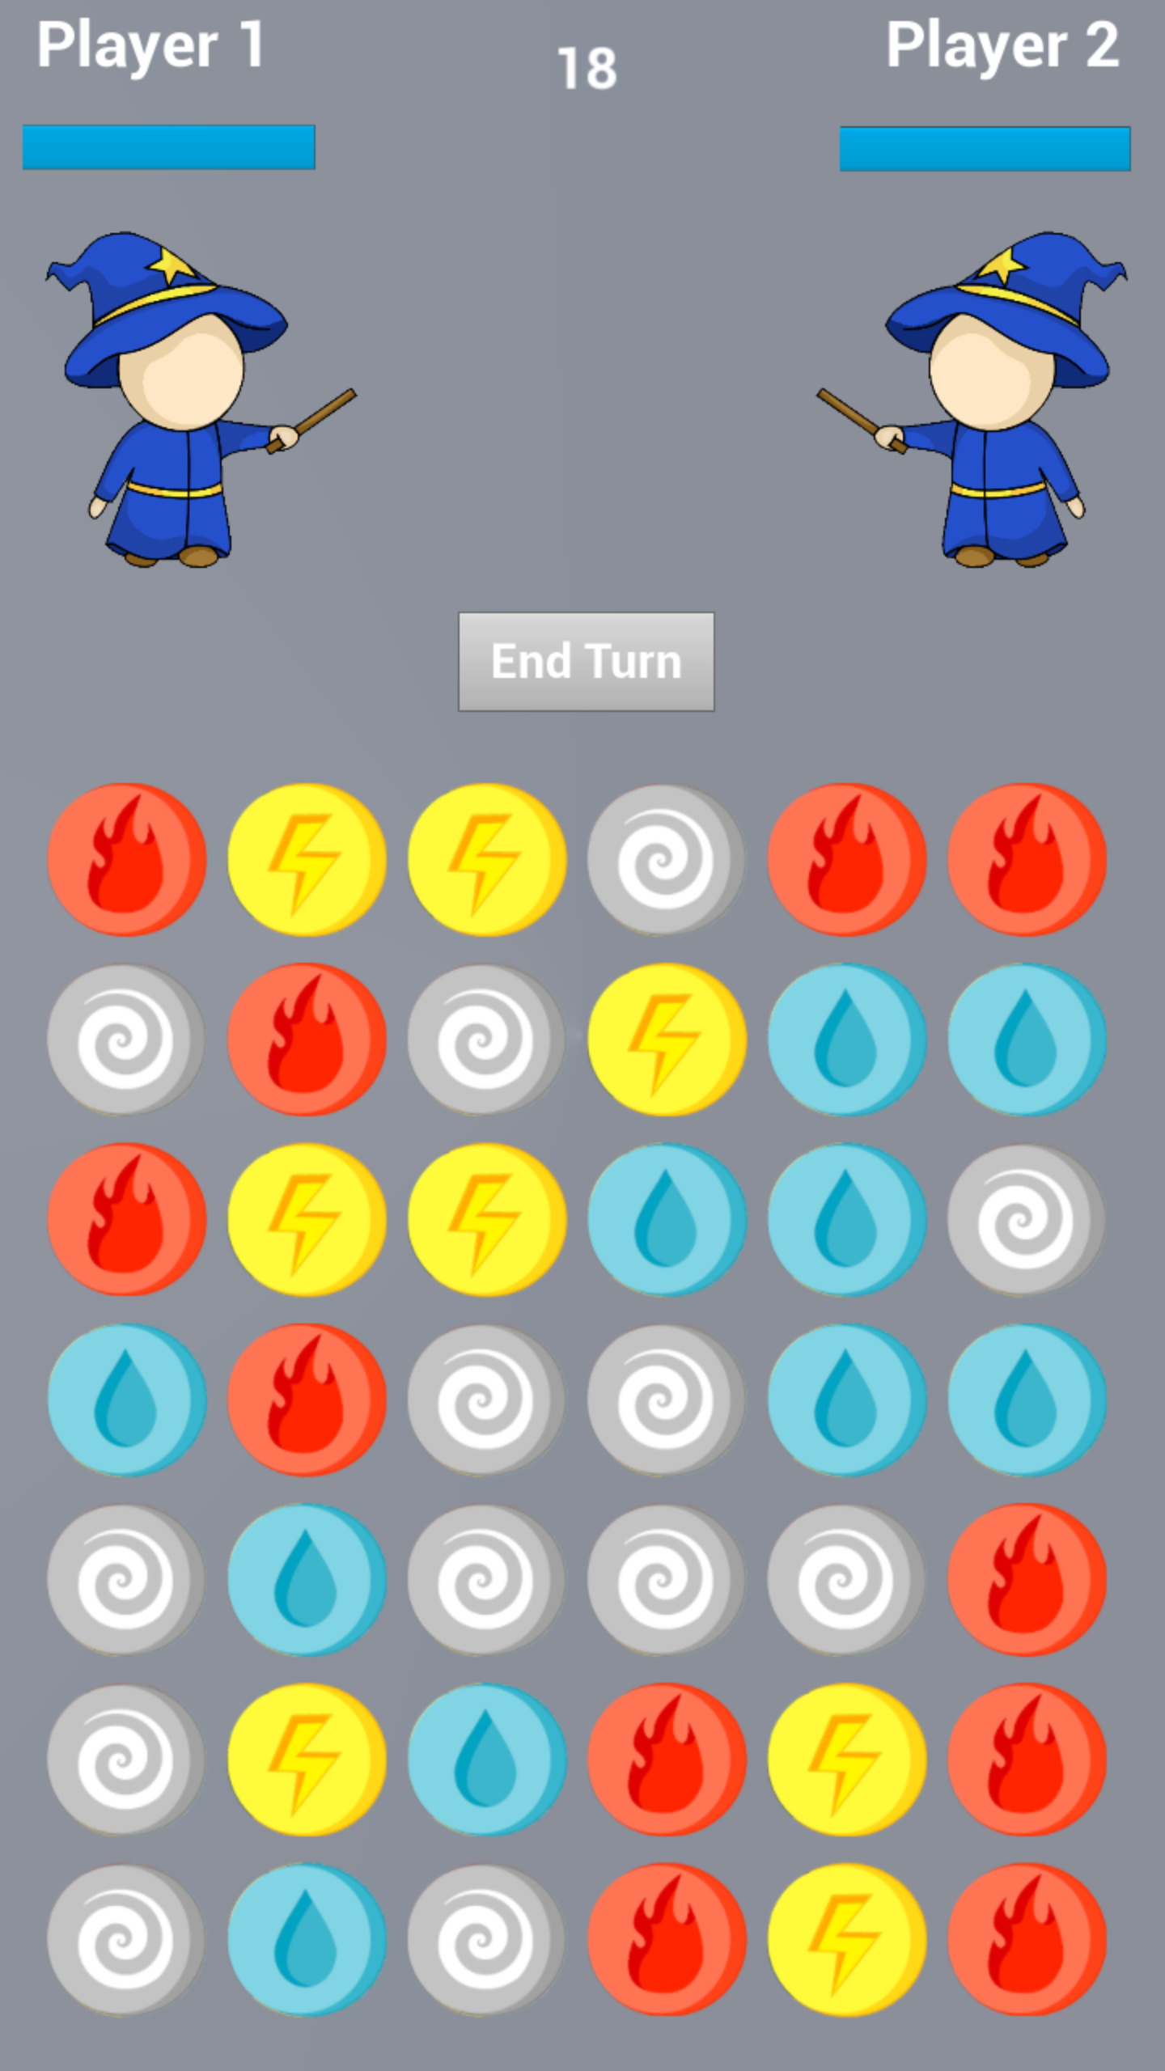
Game Basics
Turn based
Competitive puzzle game
Magic theme
Casual gamers aged 24-40

Slide 4
Core Game Loop
Player 1 Selects Matching Tiles
Damages Player 1
Damages Player 2
Player 2 Selects Matching Tiles

Slide 5
Gameplay
Link to video here WOW

Slide 6
Art Style/Theme
Cute /Cartoon
Simple
Affordances
Magic

Slide 7
Playtesting Iteration - Art
Tile selection
Animations
Tiles
Wizards

Slide 8
Playtesting Iteration - Mechanics
Damage values
Powerups
Reset Tile Map

Slide 9
Moving Forward
Healing tiles
Polishing
Animations
Emotions
Power up’s

